Slide 1
Functions. Part1
By Anastasiia Khudnytska

Slide 2
What is a Function?
A function is a subprogram designed to perform a particular task.
Functions are executed when they are called. This is known as invoking a function.
Values can be passed into functions and used within the function.
Functions always return a value. In JavaScript, if no return value is specified, the function will return undefined.
Functions are objects.

Slide 3
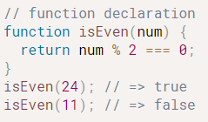
Function Declarations
Declared functions are not executed immediately. They are "saved for later use", and will be executed later, when they are invoked (called upon).
function functionName(parameters) { // code to be executed }
The function declaration creates a variable in the current scope with the identifier equal to the function name. This variable holds the function object.
The function variable is hoisted up to the top of the current scope, which means that the function can be invoked before the declaration.

Slide 4
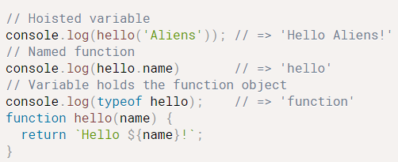
Function Declarations
The function declaration function hello(name) {...} create a variable hello that is hoisted to the top of the current scope. hello variable holds the function object and hello.name contains the function name: 'hello'.

Slide 5
JavaScript Function Scope
In JavaScript there are two types of scope:
Local scope
Global scope
JavaScript has function scope: Each function creates a new scope.
Scope determines the accessibility (visibility) of these variables.
Variables defined inside a function are not accessible (visible) from outside the function.

Slide 6
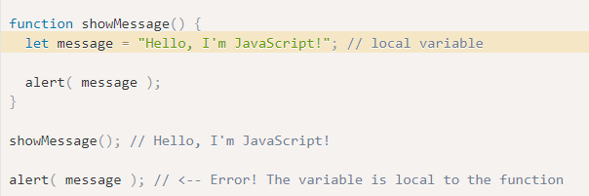
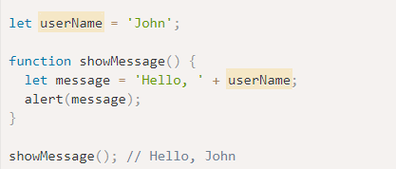
Local/Global Variables
Global variables
A variable declared outside a function, becomes GLOBAL.
A global variable has global scope: All scripts and functions on a web page can access it.
Local variables
A variable declared inside a function is only visible inside that function.

Slide 7
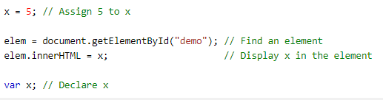
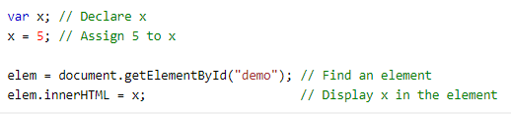
Hoisting
JavaScript Declarations are Hoisted.
In JavaScript, a variable can be declared after it has been used.
In other words; a variable can be used before it has been declared.
1
2

Slide 8
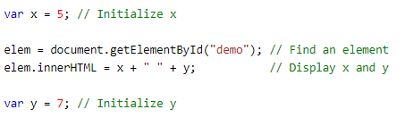
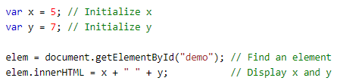

Hoisting
JavaScript Initializations are Not Hoisted
JavaScript only hoists declarations, not initializations.
2
1
To avoid bugs, always declare all variables at the beginning of every scope.

Slide 9



Arrow Function
Arrow functions were introduced in ES6.
Arrow functions allow us to write shorter function syntax:
Before:
With Arrow Function:
Arrow functions do not have their own this. They are not well suited for defining object methods.
Arrow functions are not hoisted. They must be defined before they are used.
Arrow functions can’t run with new. Not having this naturally means another limitation: arrow functions can’t be used as constructors. They can’t be called with new.

Slide 10
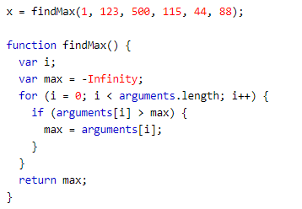
Arguments (ES5)
In Javascript, arguments is a local JavaScript object variable that is available in all non-arrow functions. arguments is an Array-like object accessible inside functions that contains the values of the arguments passed to that function.
This way you can simply use a function to find (for instance) the highest value in a list of numbers:

Slide 11
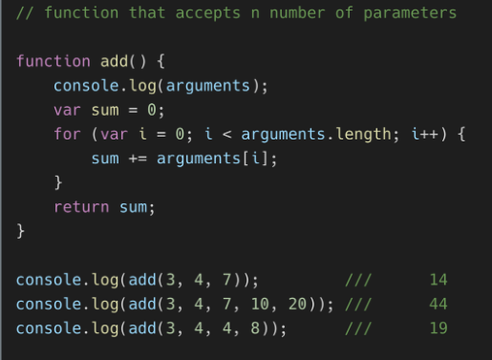
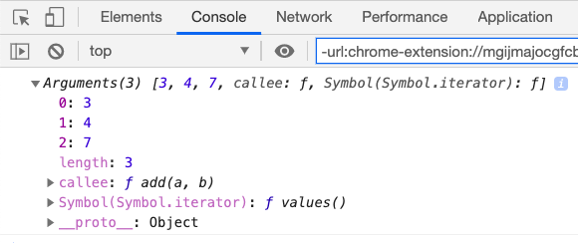
Arguments (ES5)
The above screenshot represents the arguments object in the console.

Slide 12
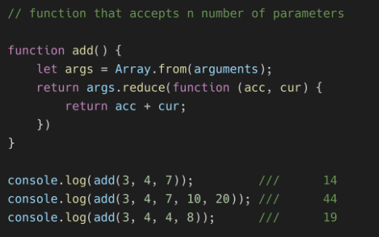
Arguments (ES5)
Since the arguments object isn’t an array, we first have to convert it into an array using the Array.from method before we can use the reduce method.

Slide 13
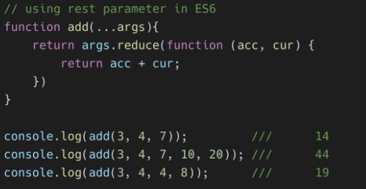
Rest Parameters (ES6)
The rest parameter provides an easier and cleaner way of working with an indefinite number of arguments. Using the rest parameter, which is the same syntax as the spread operator, we can pass an indefinite number of parameters to our function.
The main difference between rest parameters and the arguments object is:
All the array methods like map, sort, filter can be applied directly on the rest parameters array but not on the arguments object. To use Array methods on the arguments object, it must be converted to a real array first.
The arguments object is not available in arrow functions.

Slide 14
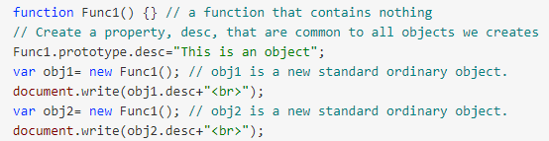

Function object
In JavaScript, functions are objects.
We can not only call them, but also treat them as objects: add/remove properties, pass by reference etc.
Creating a Function object:
In contrast to standard ordinary object, function objects have also a prototype property that we can use to add properties. These properties will then be common to all new objects we create.
The prototype property is a reference to a standard ordinary object that contains all the properties that are common to all objects that will be created.

Slide 15
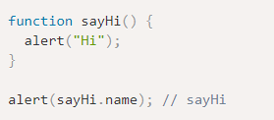
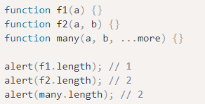
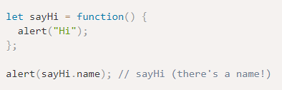
Function object
The “name” property
The “length” property
There is another built-in property “length” that returns the number of function parameters.
Here we can see that rest parameters are not counted.

Slide 16
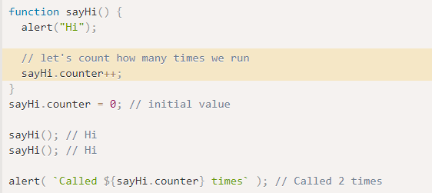
Function object
Custom properties
We can also add properties of our own.
Here we add the counter property to track the total calls count:
A property is not a variable

Slide 17


